Slide 1

Transforming the Dairy Supply Chain through Innovation, Collaboration & Growth

Slide 2
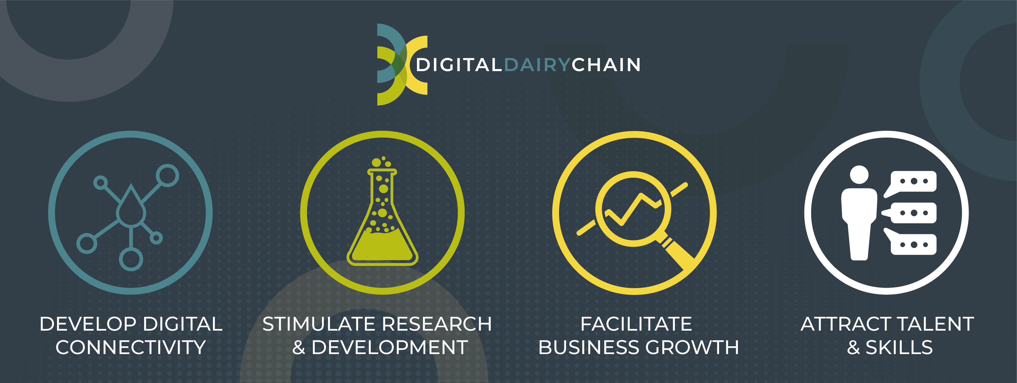
The Digital Dairy Chain offers any business or individual involved in the dairy supply chain across Cumbria, South and West Scotland a range of services to support innovation and productivity through collaboration.

Slide 3

This is a five-year, UK Research & Innovation funded project, with a budget of £21 million to transform the dairy sector in the region and uplift the rural economy, via grant funding and sustainable solutions.

Slide 4
Over a 5-year period the project aims to:
Develop Digital Connectivity: Utilising advanced technology & research to add value and connect the sector in the region
Facilitate R&D: Provide the infrastructure and expertise to enable collaborative R&D projects
Support Business Growth: For early ventures, scale-up businesses, and established companies to undertake New Product Development and process improvement
Attract Talent & Skills: Showcase the industry and create opportunities for new talent to discover the range of roles within modern dairying

Slide 5
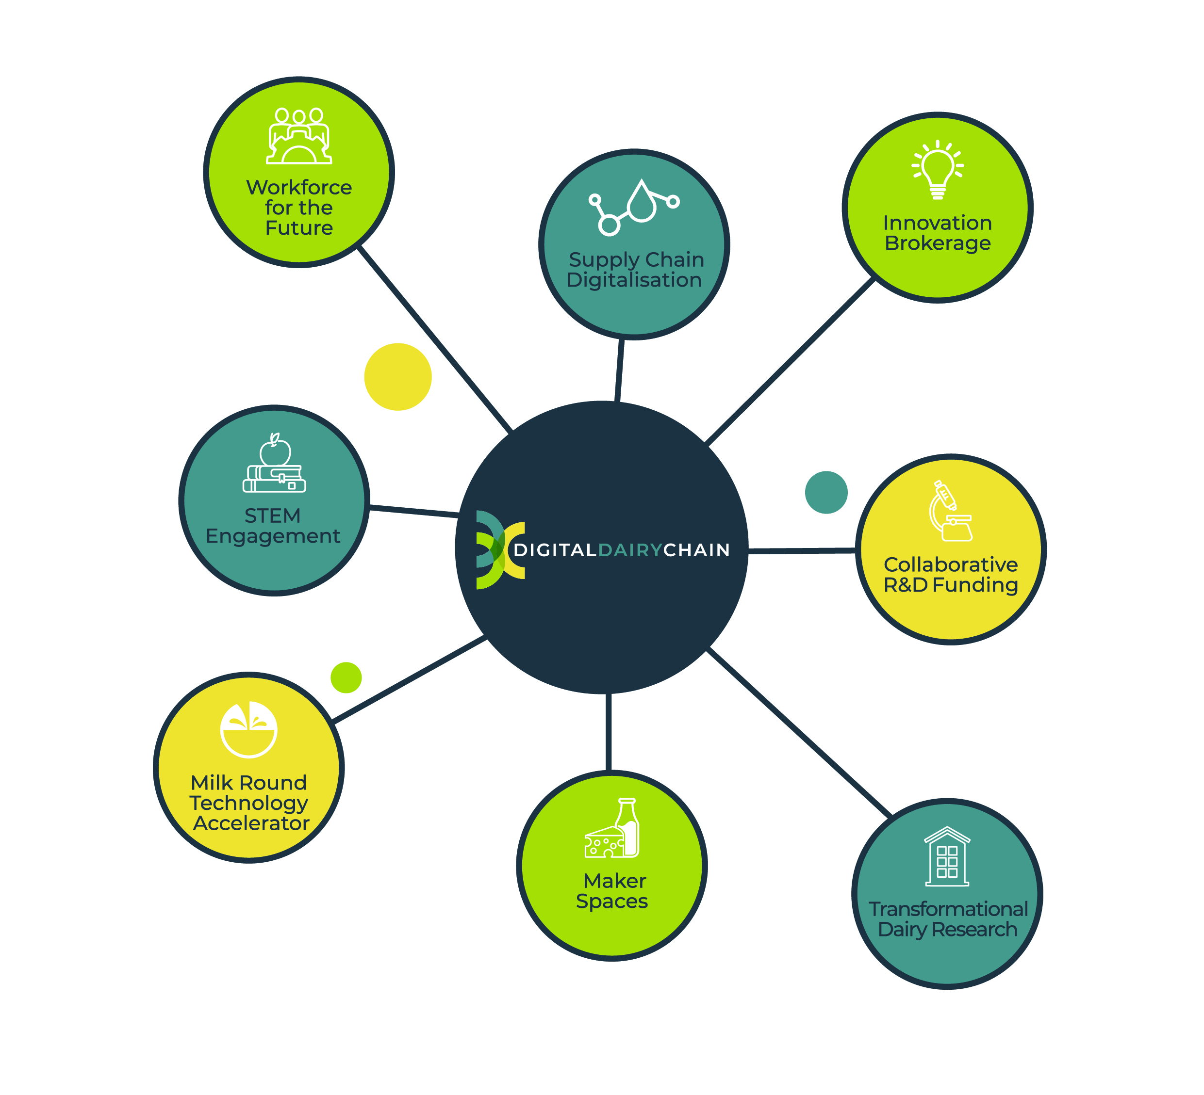
Digital Dairy Chain will deliver its ambitious objectives through eight overlapping project initiatives.

Slide 6
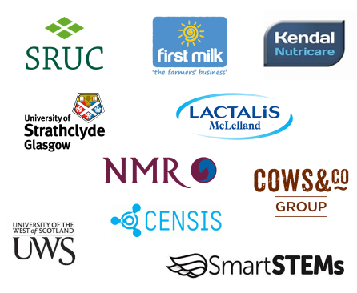
The Digital Dairy Chain is funded through UK Research and Innovation’s (UKRI) flagship ‘Strength in Places’ programme. The fund was awarded to the project’s 10 grant-drawing partners, of which SRUC is the lead partner.

Slide 7
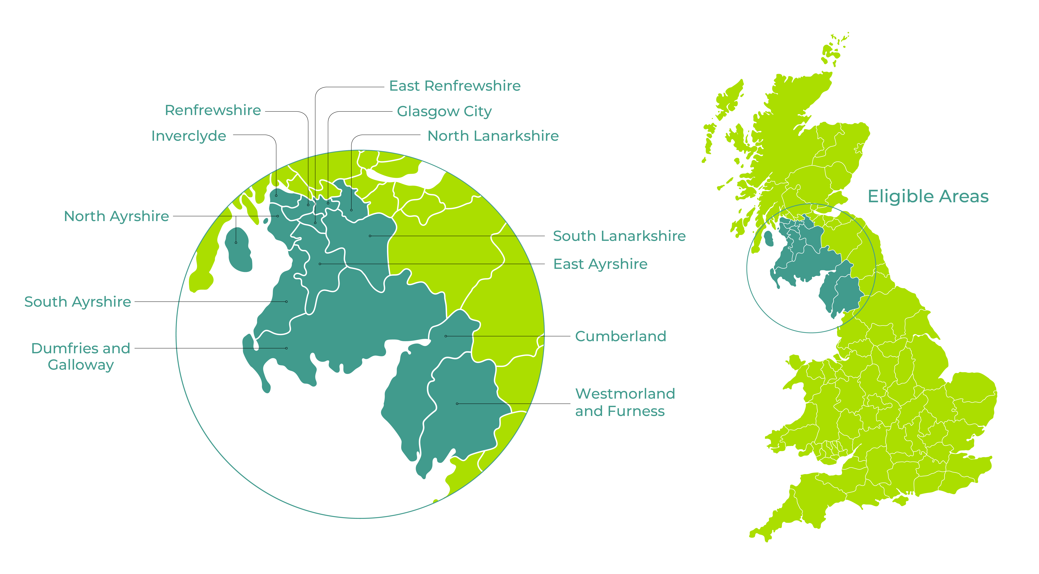
Our Geography

Slide 8

The UK is the third-largest milk producer in Europe and eleventh in the world. It produces 14.9 billion litres each year.
Global demand is expected to grow by around 5% per annum to 2025.
Cumbria and South & West Scotland is the UK’s second largest milk field, producing 1.9 billion litres each year, with a farm-gate value of £750 million. There are 52 dairy manufacturing businesses adding value to milk produced from 1,300 farms.

Slide 9
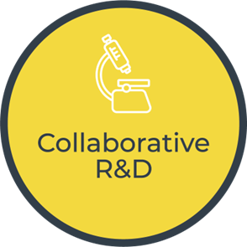
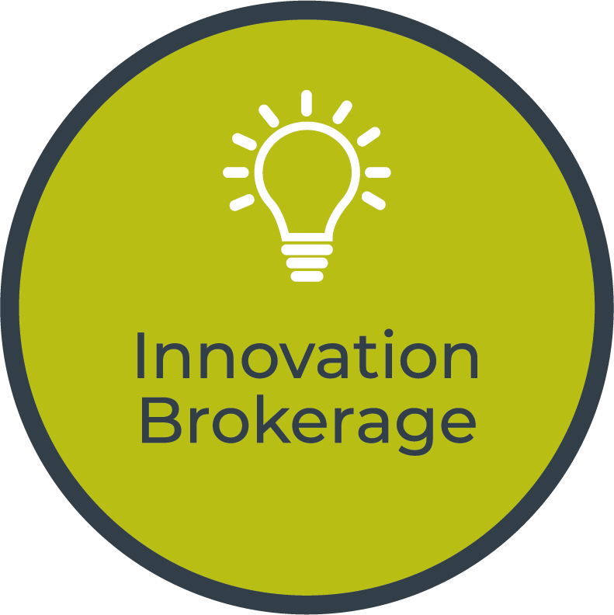
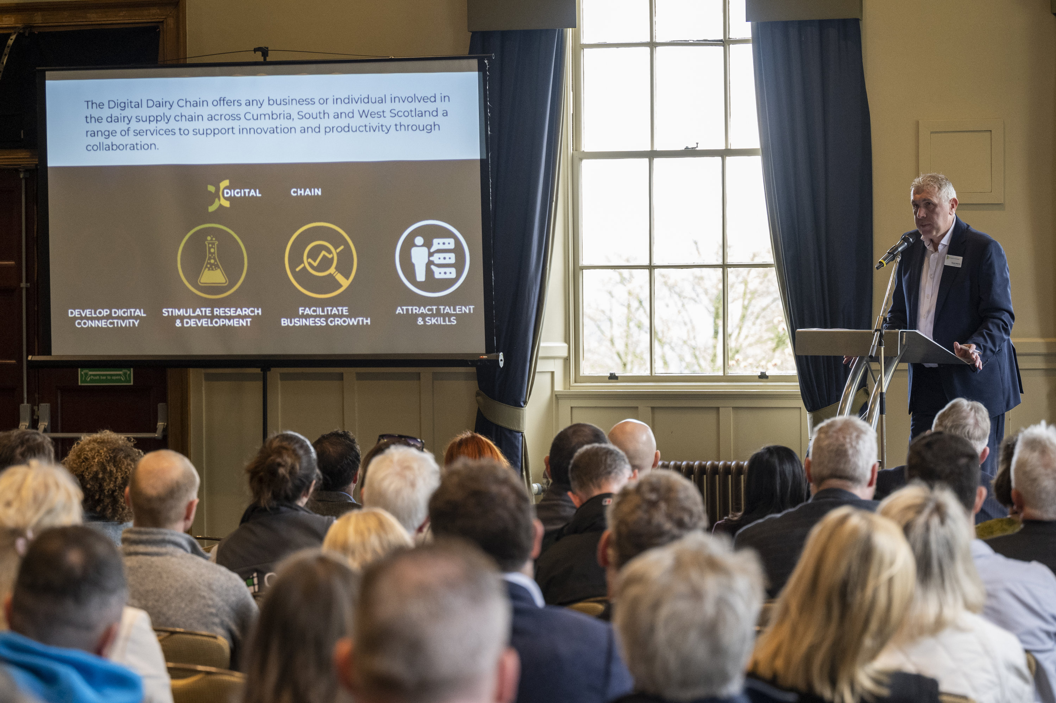
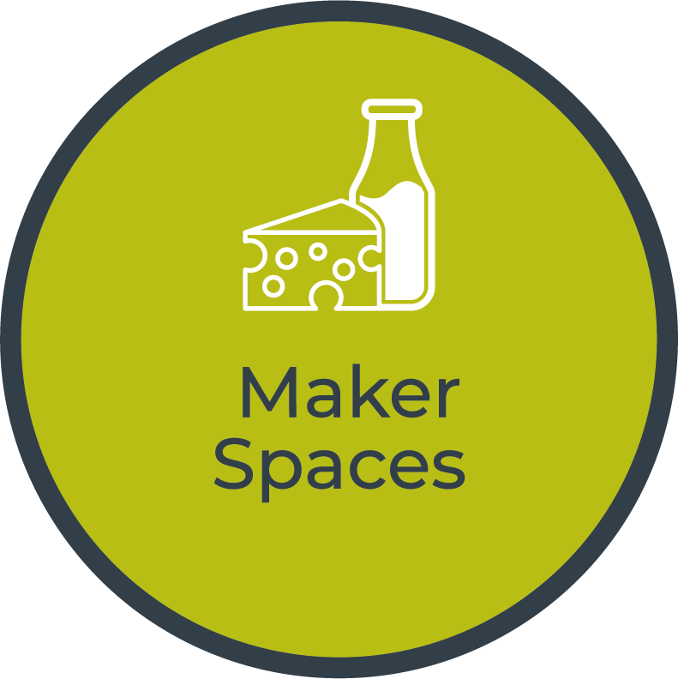
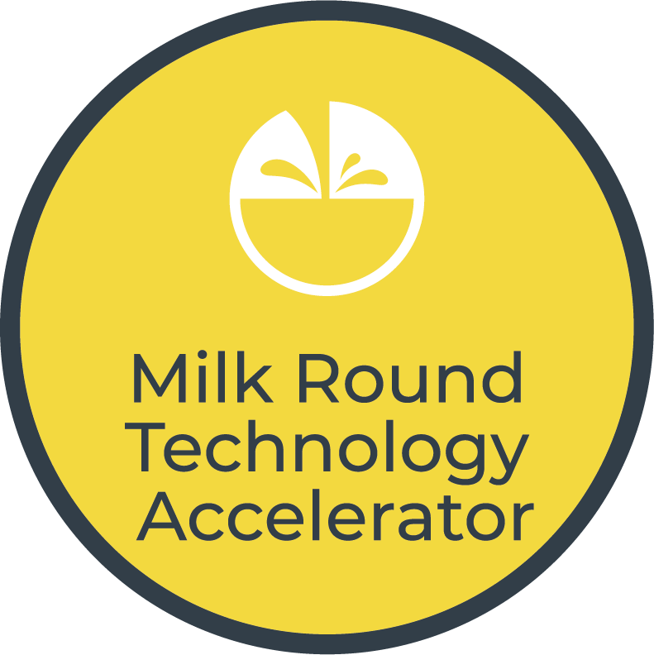
Of the eight individual programmes of activity in operation through the Digital Dairy Chain there is four tranches of funding and direct business support available; the Collaborative R&D Funding Competition, Innovation Vouchers, the Milk Round Technology Accelerator and the Maker Space NPD Facilities.

Slide 10
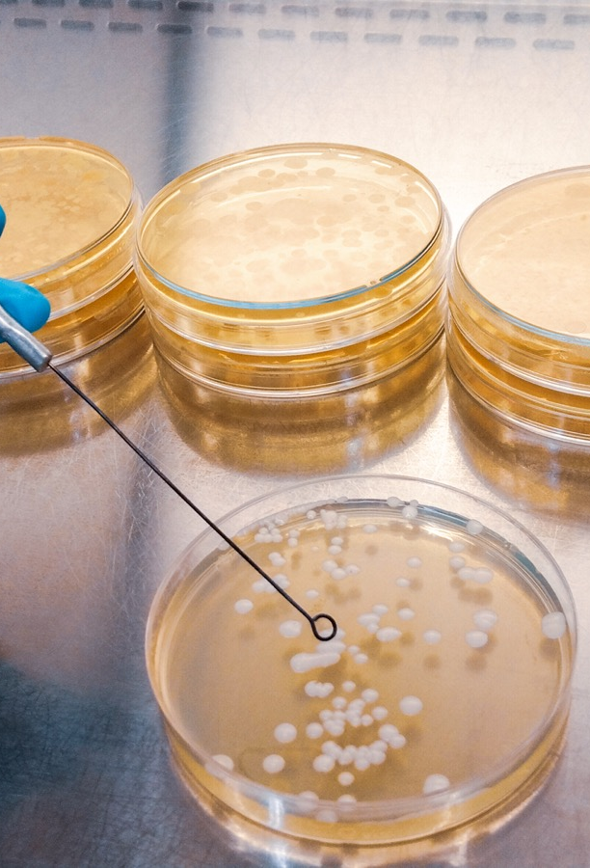
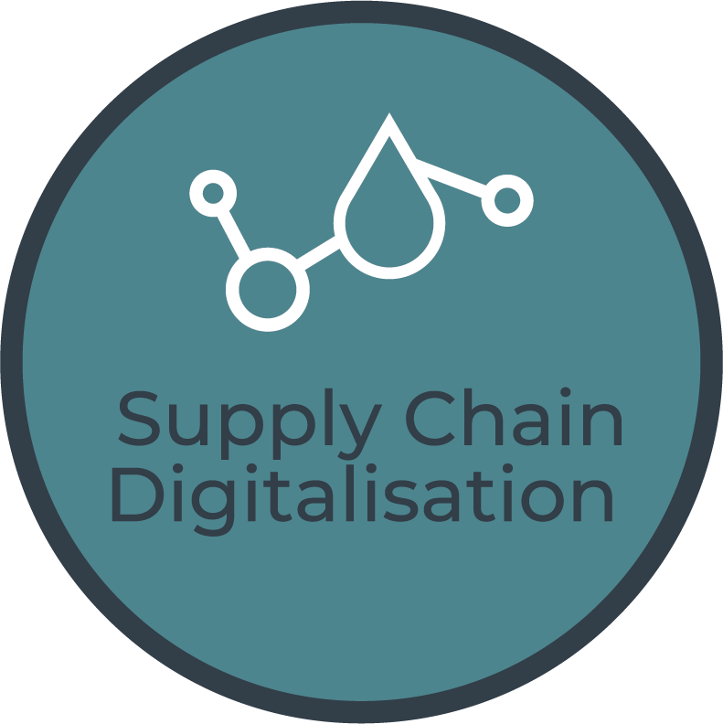
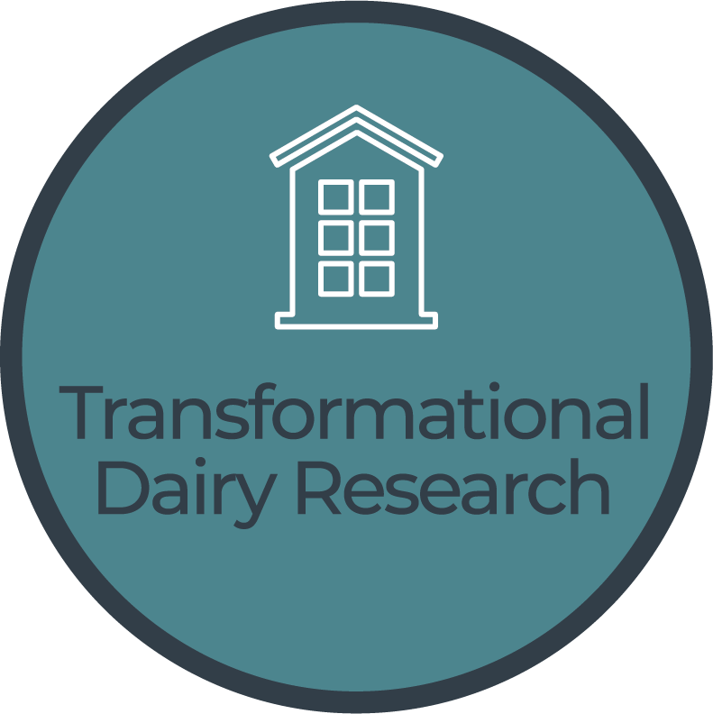
The Supply Chain Digitalisation project focuses on collaboration between dairy industry and academics to connecting the whole supply chain from grass to glass.
The collaborators are developing new technologies to address the challenges faced by the dairy sector.
The Transformational Dairy Research project will focus on innovation and the latest research in on-farm and downstream milk processing technologies, with the aim of maximising the value of milk and reducing energy consumption and waste in processing and storage.

Slide 11
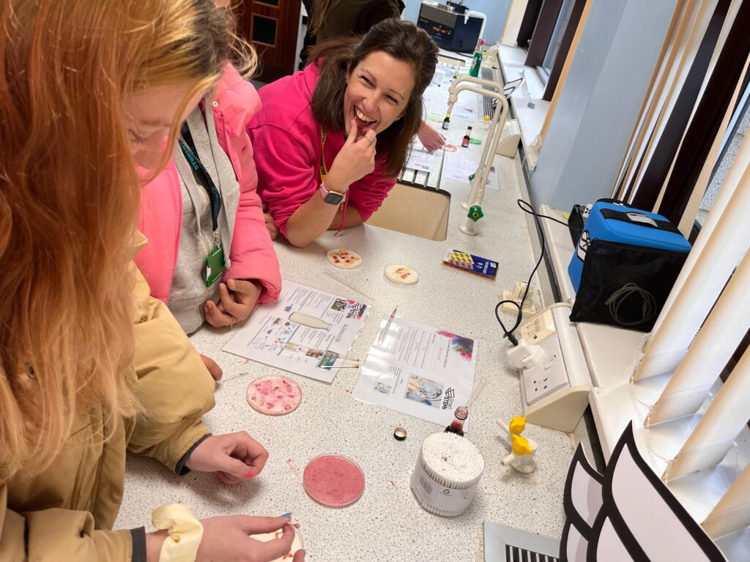



Alongside these funding and research schemes the Digital Dairy Chain is also running several education and engagement projects; STEM Engagement and Workforce for the Future.
These projects will address the urgent skills shortage the industry faces as well as showcasing the range of opportunities for young people in modern dairying.

Slide 12
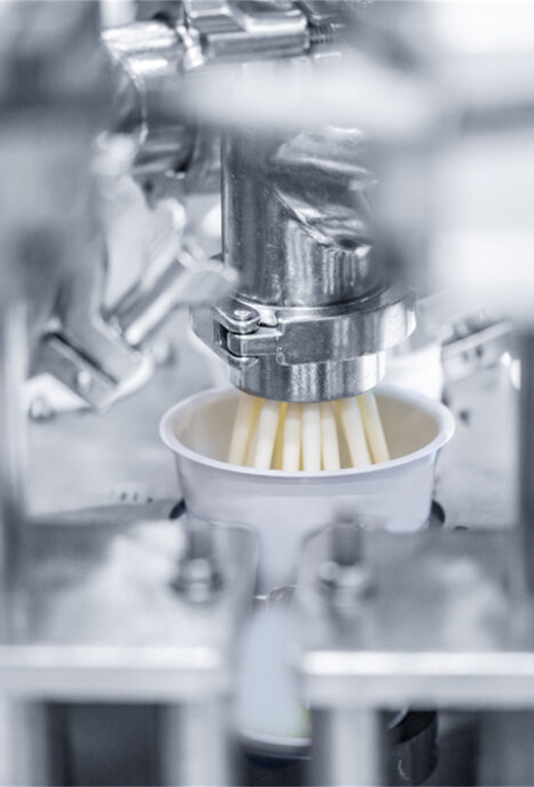

Discover the opportunities available to you…
www.digitaldairychain.co.uk
Follow us on

